Slide 1
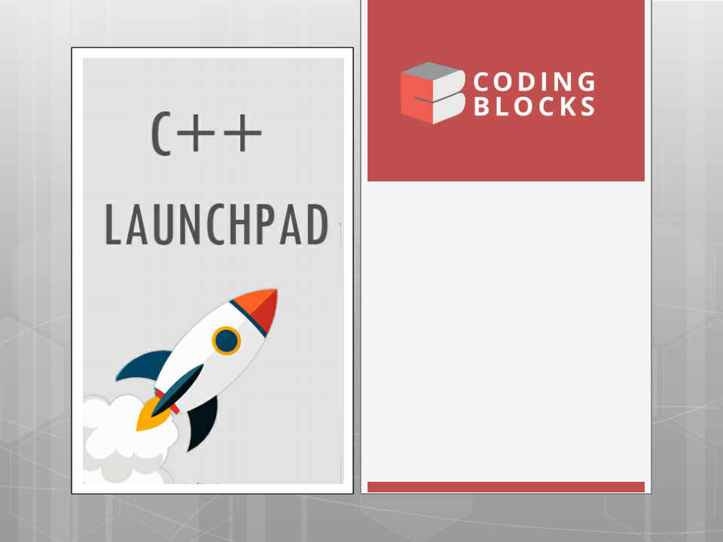
Lecture-6
Pointers
•
Address
Pointers
Of
Operator
•
•
Dereferencing Pointers
Kartik Mathur

Slide 2

Doubts ?

Slide 3
3
Initialization of Array.

Slide 4
Pointers

Slide 5
June 20, 2018
Address of Operator (&)
To get the address of a variable, we can use the
address-of operator (&)
* Address is stored in hexadecimal format.
int p = 5;
cout << &p << endl; // It will print address of the
variable;
-----------------------------
int arr[3];
cout << arr << endl; // it will show you address of
first element.
cout << &arr[0] << endl; // same as above.

Slide 6
September 10,
2018
Address of Operator (&)
What will be the output?
char ch = ‘A’;
char *xch = &ch;
cout << &ch << endl;
cout<<xch<<endl;
Here we need to fool the compiler !
o cout<<(void *)&ch;
ocout<<(float*)xch;

Slide 7
September
10,
7
2018
What are pointers?
Pointers are one of the most powerful and
confusing aspects of the C/C++ language.
A pointer is a variable that holds the address
of another variable.
To declare a pointer, we use an asterisk
between the data type and the variable
name

Slide 8
September 10,
2018
Declaring a pointer variable!
int *pnPtr; // a pointer to an integer value
double *pdPtr; // a pointer to a double value
int* pnPtr2; // also valid syntax
int * pnPtr3; // also valid syntax
int *pnptr1, *pnptr3 // Declaring Multiple pointers.
Note – The space between the type and
variable name.

Slide 9
September 10,
2018
Initializing the pointer variable.
Pointer variable when declared store some
arbit collection of 1s and 0s. So we can say
that they are pointing to some garbage
address.
We can initialize the pointer variable to some
valid address i.e. address of same type of
valid memory.
Int x = 10; int *q= &x;
We should never store address of a different
type in the pointer variable.

Slide 10
Dereference Operator (*)
An interesting property of pointers is that they can
be used to access the variable they point to
directly. This is done by preceding the pointer
name with the dereference operator (*). The
operator itself can be read as "value pointed to
by”
Therefore the value pointed by q in previous
example can be accessed as
int r = *q;
// or
cout << *q << endl;
// or
Int z = (*q) + 1;

Slide 11
11
So what is * ?
Using * in a declaration of variable or as a
is only signifying that this
variable is meant to store an address.
Using * in an expression can mean two things
As binary operator - Multiplication
As unary operator – Dereferencing the
address.
function argument -

Slide 12
Assignment in pointers
A pointer variable is assignable – it means
that we can change the address which it is
storing now.
int x = 10, y = 20;
int *ptr = &x; // Now ptr is storing address of x
ptr = &y; // Now ptr is storing address of y;
Assigning value which is being pointed at by
the variable.
*ptr = 25; // This would change the value to
which ptr is pointing to i.e. now y would become
25.

Slide 13




Assignment in pointers
Tell the output of the following? : x, y are INT
200
100
100
10
y x
x
&x
y
&y
*(&x)
&(*y)
x+1
&x+1
y+1
*y+1
*(&y)

Slide 14
Lets write some code.

Slide 15
We should never de-reference any
garbage address !
So Always initialize your pointer with
NULL.

Slide 16
September 10,
2018
Null Pointer
Sometimes it is useful to make our pointers
point to nothing. This is called a null pointer.
We assign a pointer a null value by setting it to
address 0:
double *p = 0;
Dereferencing Null pointer always gives
segmentation fault.

Slide 17
September
10,
17
2018
Pointers and Functions

Slide 18
September
10,
18
2018
Address are also passed by value
to a function!

Slide 19
September
10,
19
2018
Pointers and Arrays!
Pointers and arrays are intricately linked in the C
language
An Array is actually a pointer that points to the
first element of the array! Because the array
variable is a pointer, you can dereference it,
which returns array element 0:
a[i] is same as *(a + i)
Note – An array name is just an alias to address of
first element. There is no separate storage for the
variable name. It behaves as a pointer but is not
actually a pointer.

Slide 20
September 10,
2018
Lets see some code!
Write a function to update the value of an
user input x?
Write a function that print all the elements of
an array and another function that reverse
the elements of an array?

Slide 21
September 10,
2018
Pointer Arithmetic
Addition, Multiplication, Division of two
addresses doesn’t make any sense.
Addition of an address by a constant integer
value i.e. ptr +5 means address of cell which
is 5 * sizeof(*ptr) away from ptr.
Similar for subtraction.
Again Multiplying/Dividing an address with
some constant value doesn’t make any
sense.
Subtracting two address of same type would
give you number of elements between
them.

Slide 22
September 10,
2018
Pointer Arithmetic contd..
Lets look at few input/output examples to
understand more clearly!

Slide 23
September 10,
2018
So when you are passing an array
to a function, you are actually
passing the address of the first
element.

Slide 24
September
10,
24
2018
Lets see some problems.
Sum of Array
Bubble Sort
Selection Sort

Slide 25
September
10,
25
2018
void sumofarray(int arr[], int N)
is same as
void sumofarray(int *arr, int N)

Slide 26
September 10,
2018
What would happen if I change
the call to
cout << sumofarray(arr+5, 10);

Slide 27
September
10,
27
2018
Pointers vs Arrays
the sizeof operator
sizeof(array) returns the amount of memory used by all elements in array
 sizeof(pointer) only returns the amount of memory used by the pointer variable
itself
the & operator
&array is an alias for &array[0] and returns the address of the first element in
array
&pointer returns the address of pointer
Pointer variable can be assigned a value whereas array variable cannot be.
int a[10];
int *p;
p=a; /*legal*/
a=p; /*illegal*/
Arithmetic on pointer variable is allowed.
p++; /*Legal*/
a++; /*illegal*/

Slide 28
September 10,
2018
Pointer as return value
We should never return address of a local
variable from a function.

Slide 29
Thank You!
Kartik Mathur
Kartik.mathur@codingblocks.com
+91-9560196180

